Slide 1
Business Case 1
Clustering – unsupervised learning
Bersani Michele
Corazza Lorena
Grignani Alessandro
Radaelli Gabriele
Schembri Salvatore

Slide 2
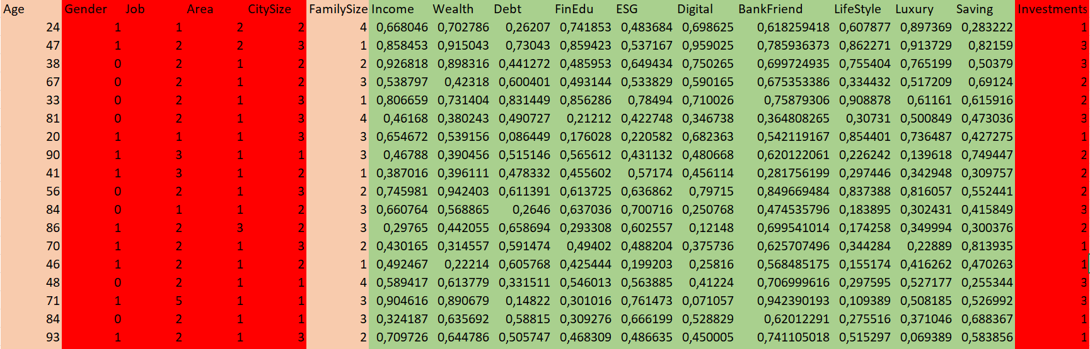
DATA PREPROCESSING
normalized numerical features
categorical features
discrete numerical features that should be normalized

Slide 3
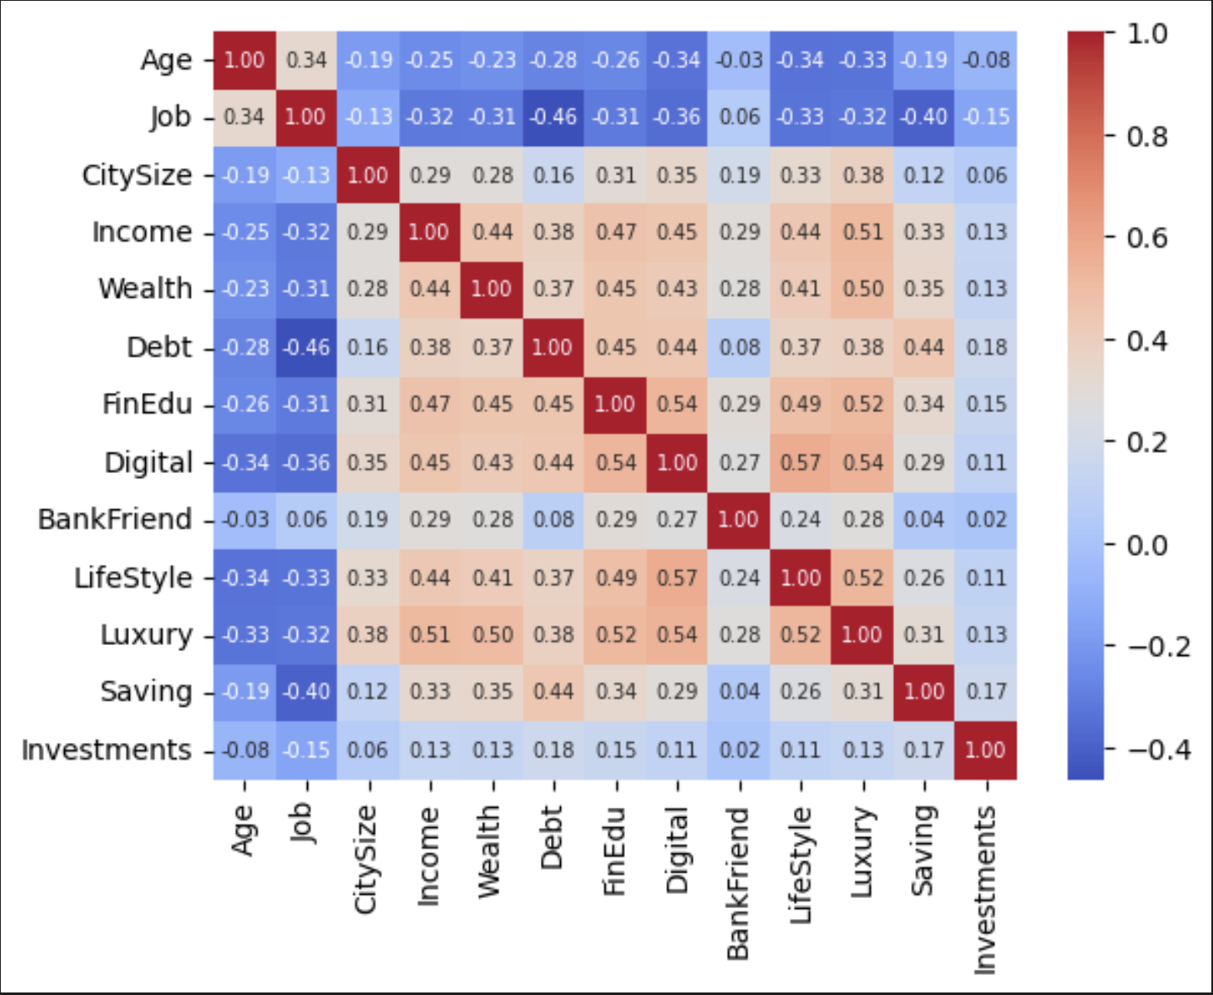
EXPLORATIVE ANALYSIS

Slide 4
ALGORITHM IDEAS FOR CLUSTERING
HIERARCHICAL CLUSTERING
K-MEDOIDS
DBSCAN
KMEANS

Slide 5
IDEA TO MANAGE THE CATEGORICAL FEATURES
distances _matrix= 12/17*num_features_distances+ +5/17*cat_features_distances
Since we have 5 categorical variables and 12 numerical variables
We weighted the distance matrix using
Euclidean distance for the numerical features
Hamming distance for the categorical ones

Slide 6
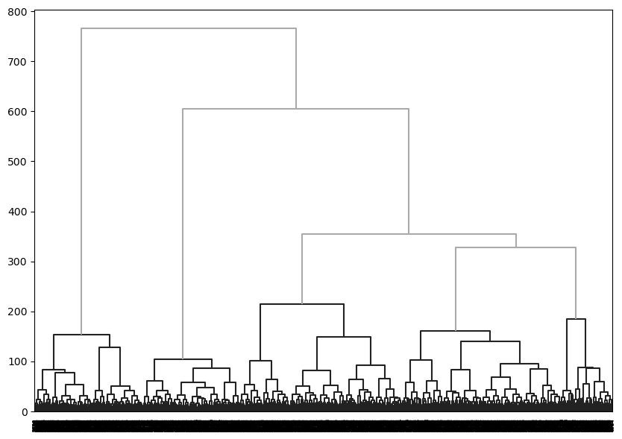
HIERARCHICAL CLUSTERING------> 6 clusters

Slide 7
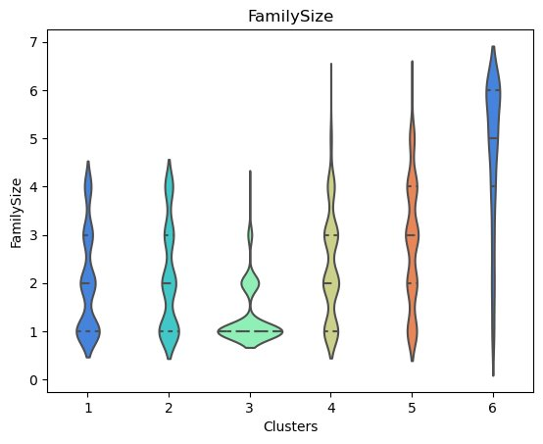
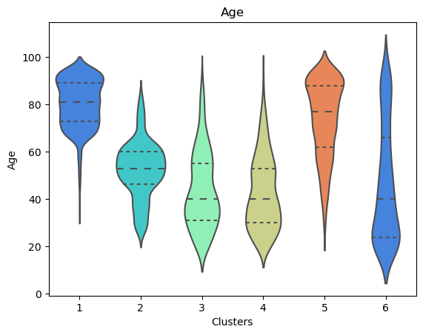
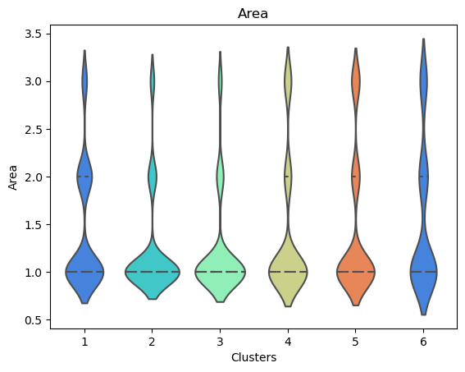
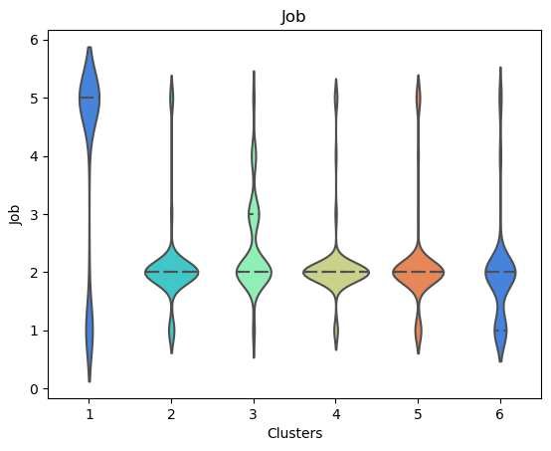
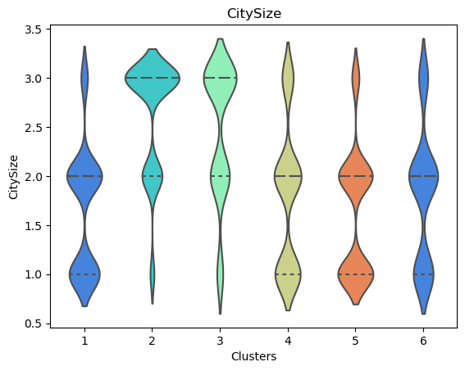
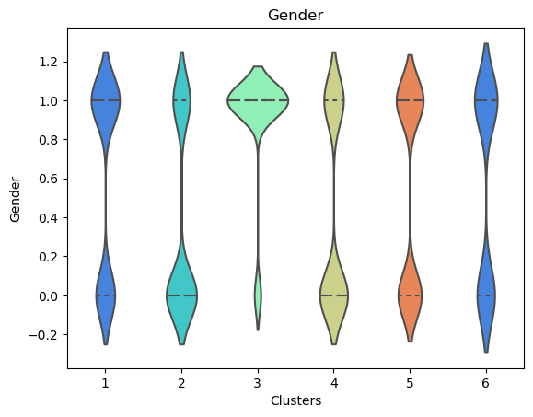
SIGNIFICATIVE FEATURES
Notes:
MIA IDEA QUI è LASCIARE. I GRAFICI DELLE ENTITà Più CARATTERIZZANTI perché AL MASSIMO POI LE ALTRE LE FACCIAMO VEDERE TRAMITE IL CODICE

Slide 8
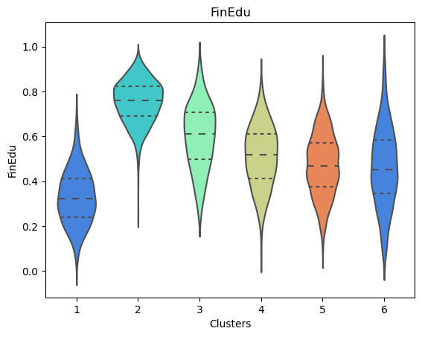
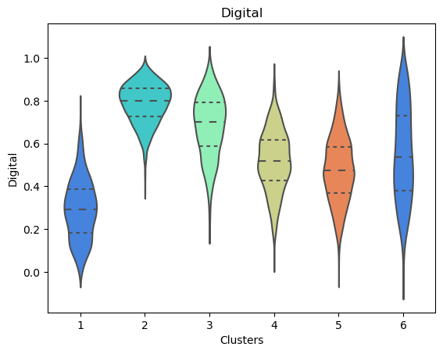
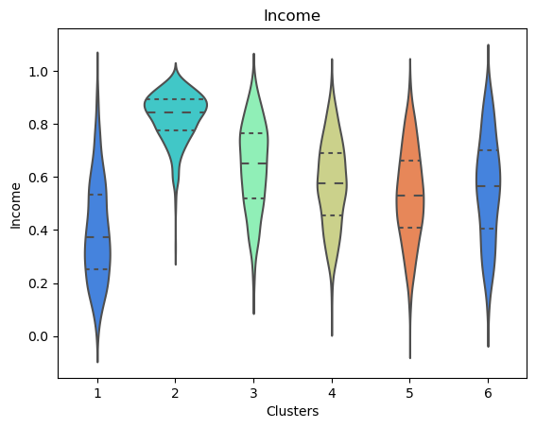
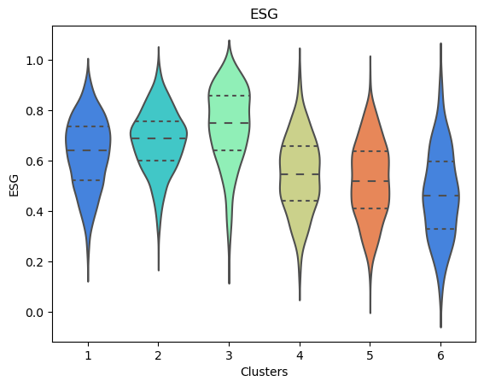
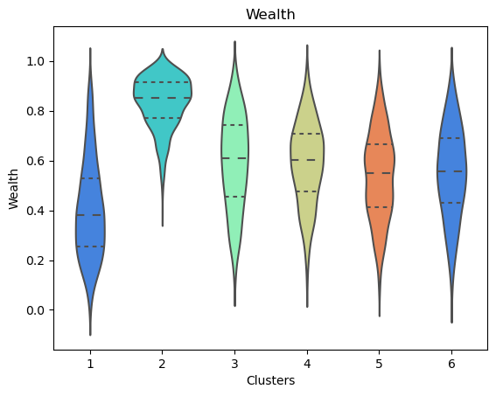
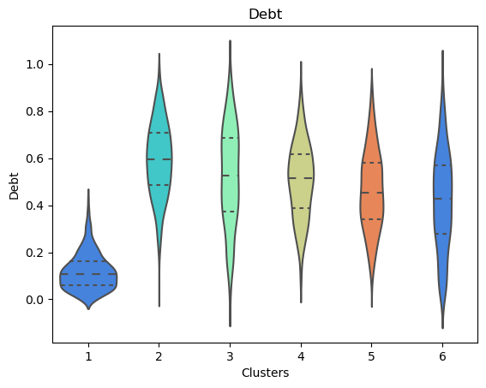

Slide 9
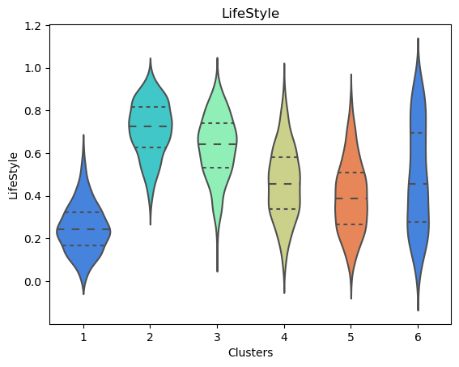
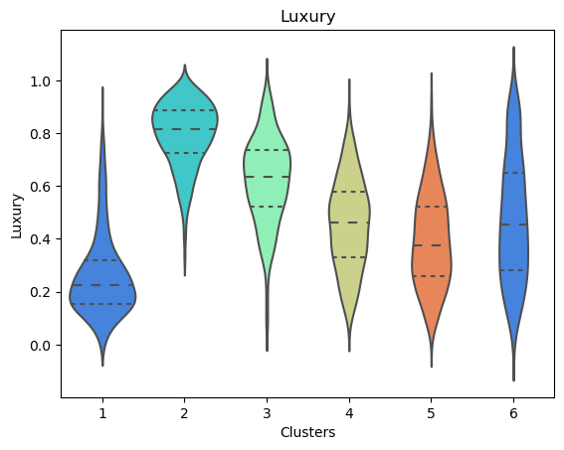
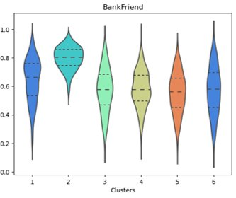
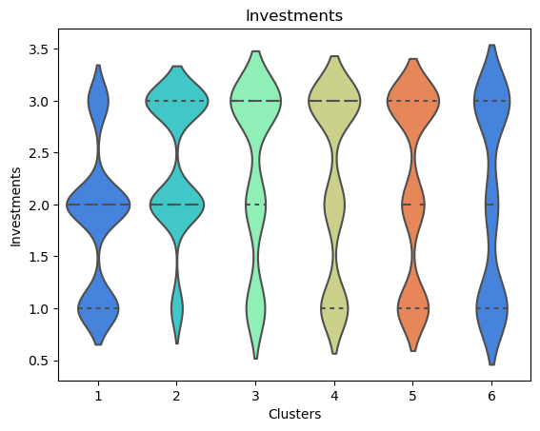
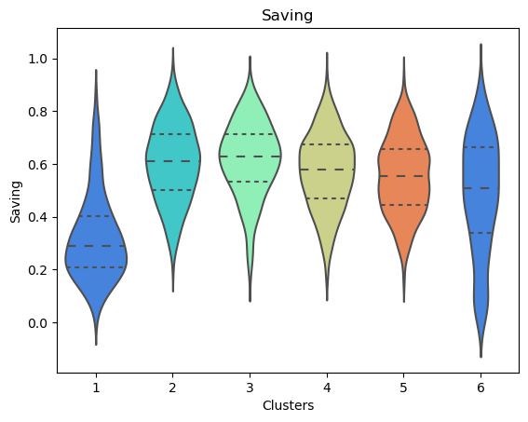

Slide 10
 | CL1 | CL2 | CL3 | CL4 | CL5 | CL6 | Comment
Age | 80 | 50 | 40 | 40 | 65 | 20 | Age, in years
Gender | Female | Male | Female | Male | Female - Male | Female | Gender (Female = 1, Male = 0)
Job | pensionato | impiegato/operaio | impiegato/operaio- quadro/dirigente | impiegato/operaio | impiegato/operaio | impiegato/operaio - non occupato | 1=non occupato, 2=impiegato/operaio, 3=quadro/dirigente, 4=imprenditore/libero professionista, 5=pensionato)
Area | Nord - Centro | Nord | Nord | Nord | Nord | Nord - Centro | 1=Nord, 2=Centro, 3=Sud/Isole
CitySize | cittadina medie - piccolo | Grande - medio | Grande - medio | Piccolo - medio | Piccolo - medio | Medio - piccolo | 1=piccolo centro, 2=cittadina medie dimensioni, 3=grande città >200k
FamilySize | 1 | 1 | 1 | 2 | 3 | 6 | Number of components
Income | 0.4 | 0.9 | 0.6 | 0.6 | 0.5 | 0.6 | Normalized Income (percentiles)
Wealth | 0.4 | 0.8 | 0.6 | 0.6 | 0.5 | 0.5 | Normalized Wealth (percentiles)
Debt | 0.1 | 0.6 | 0.5 | 0.5 | 0.4 | 0.4 | Normalized Debt (percentiles)
FinEdu | 0.3 | 0.7 | 0.6 | 0.5 | 0.4 | 0.4 | Normalized Financial Education (percentiles)
ESG | 0.6 | 0.65 | 0.7 | 0.5 | 0.5 | 0.45 | Normalized ESG propensity (percentiles)
BankFriend | 0.75 | 0.8 | 0.6 | 0.6 | 0.6 | 0.6 | Normalized Bank Friendliness (percentiles)
LifeStyle | 0.2 | 0.7 | 0.6 | 0.4 | 0.35 | 0.2 | Normalized Lifestyle Index (percentiles); higher values =
Luxury | 0.2 | 0.8 | 0.6 | 0.4 | 0.35 | 0.2 | Normalized Luxury spending (percentiles)
Saving | 0.3 | 0.6 | 0.6 | 0.55 | 0.5 | 0.5 | Normalized Saving propensity (percentiles)
Investment | No investment – Lump sum | Capital – lump sum | Capital – lump sum | Capital – no inve. | Capital – no inv. | Capital – no inv. | Investment type: 1 = no investments; 2 = mostly lump sum; 3 = mostly capital accumulation
Digital | 0.3 | 0.8 | 0.7 | 0.5 | 0.5 | 0.5 | Normalized Digital propensity (percentiles)

Slide 11
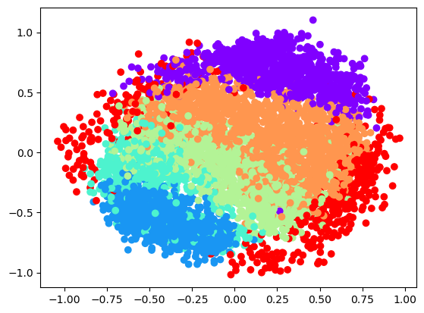
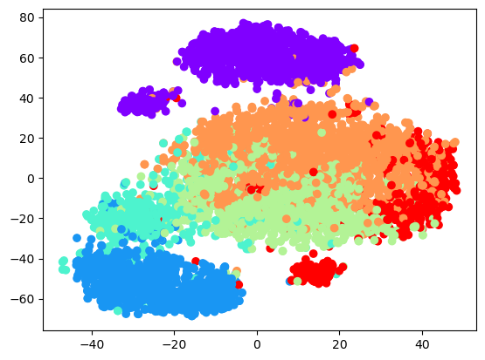
MULTIDIMENSIONAL SCALING
T-SNE

Slide 12
Analisi personas
Given a dataset about informations of clients of a bank, we to perform a clustering between them.
We tried different types of methods:
HIERARCHICAL CLUSTERING
K-MEDOIDS
DBSCAN
KMEANS

Slide 13
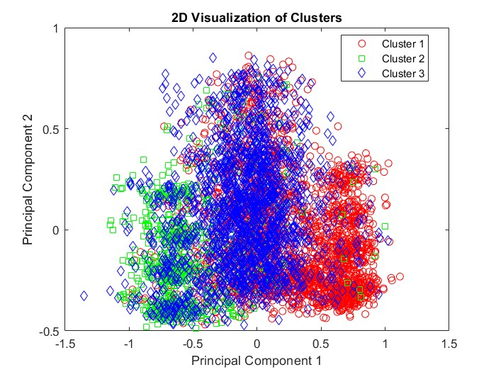
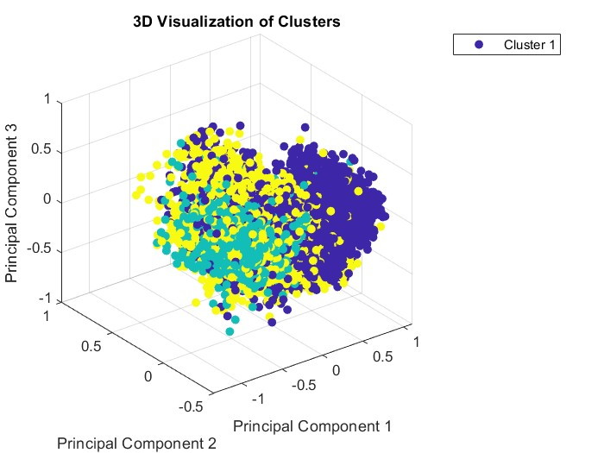
K-MEDOIDS

Slide 14
The best choice to solve the problem is HIERARCHICAL CLUSTERING ( using linkage ward.D2 since it is the one that avoid thne chain effect).
Instead we found that the DBSCAN and the K-MEANS are not so good since the computation requires directly the use of the data and so it is difficult to manage categorical variables.
We also performed the k-medoids alghorithm and it returned 3 clusters, since we are not satisfied with the result we choose the Hierarchical clustering.
We found out that some features like area and gender are not significant for the segmentation so a possible improvment can be removing this ones that represent rumors.
Reduction of categorical features like JOB that can be used only considering 2 types( retired and not retired) and INVESTMENTS in which we can use only investment and not investment
To reduce the rumors we also tried PCA but we did not obtain useful results
In conclusion the clusters highligths the characteristics
-retired, not retired
-with digital or financial education and not
-in big cities or small cities
Examples of Serivices:
Cluster 1: 80 yrs old, retired, low digital, low fin edu, no investments
Service model: physical assistance, call center,
Cluster 2: 50 yrs old, high digital, high fin edu
Service model: mobile banking app, brokerage(securities) account

Slide 15
Commenti del Zenti
Provare a togliere delle feature o creare dei pesi
Identificare la metrica cardine per evitare continue prove all’infinito
Non basarsi molto sulla parte grafica ma più sui dati (TSNE) non va molto bene a livello d’occhio per il. Clustering, ma lavorare direttamente sui dati

